Slide 1
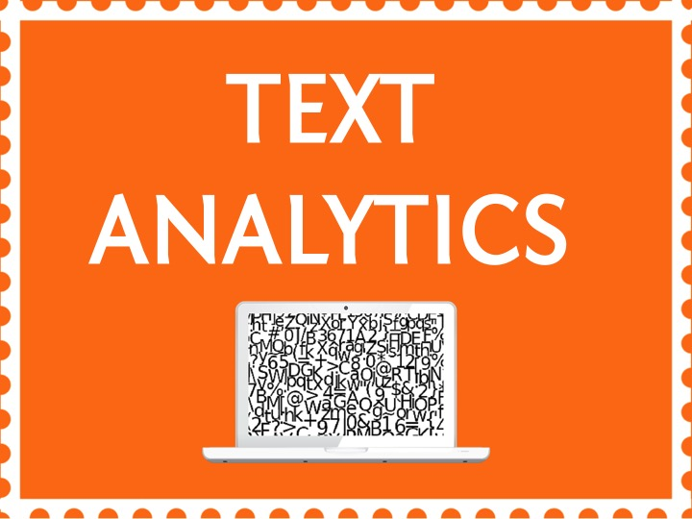

Slide 2


Topic – 5 Topic Modelling
Text Analytics
Notes:
Do we know the topic number for this?

Slide 3

INDEX
Introduction to Topic Modelling
Types of Topic modelling
Intuition of LDA
Math Behind LDA
LDA in R

Slide 4
100 M News Articles
What are they about?
Quite a problem!
Notes:
Say we have 100 M news articles
What is there in this 100 million news articles?
How will you find out what kind of articles are they? What are the topics discussed in these articles?
That is indeed quite a mind boggling thought!!.

Slide 5
Topic Models
To uncover the underlying structure of text
Notes:
The topic modelling is one approach to try and understand what the document is talking about.

Slide 6
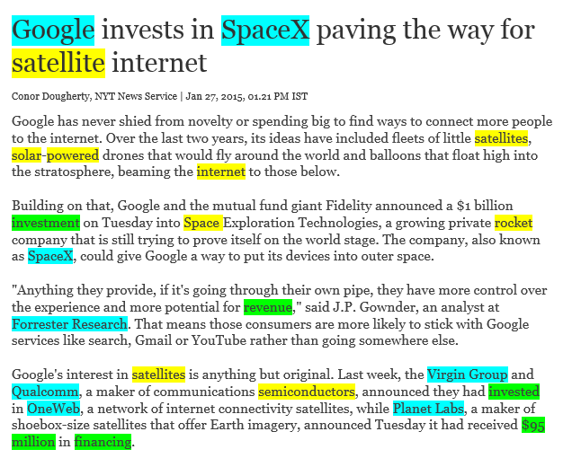
Example
Notes:
Let’s look at an example of what a topic model can do for you.
This is an example of an article from The times of India, recently.
The title is : “Google invests in …”
So from the title you can see that it is about Google investing some money in a company .It’ s also talking about which company has it partnered with and what is the product it is looking to develop, ie satellite internet
What topic models do for you is.. It uncovers what the latent topics are in the corpus….latent means hidden.
Here you can see words highlighted in 3 colors..green,yellow and blue.

Slide 7
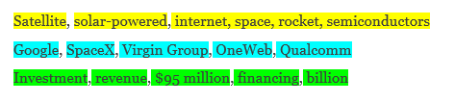
Example
DOCUMENT
TOPICS
WORDS
Notes:
Let’s take a look at the list of highlighted words.
So you see about :
Yellow →Technologies →Is about the various technologies that Google plans to collaborate with SpaceX and provide.
Blue →Companies →Is about the various companies .If you read the article, it mainly talks about investments made by Google’s competitors,etc
Green→ money→Is about finances like money, investments, how much money like billion etc.
So basically the intuition or assumption that Every topic modelling has is that
1.Every document is made up of multiple topics
2.The words in the documents are generated from multiple topics

Slide 8
INDEX
Introduction to Topic Modelling
Types of Topic modelling
Intuition of LDA
Math Behind LDA
LDA in R

Slide 9
Types of Topic Models
Latent Semantic Indexing(LSI)
Probalistic latent semantic indexing (PLSI)
Latent Dirichlet Allocation (LDA)
Notes:
Perhaps the most common topic model currently in use is LDA .So we will look at that in detail in this course.

Slide 10
INDEX
Introduction to Topic Modelling
Types of Topic modelling
Intuition of LDA
Math Behind LDA
LDA in R

Slide 11
LDA
A Generative model
Discovery by David Blei, Andrew Ng, and Michael Jordan in 2003
Notes:
LDA is one of the simplest topic models.It was Discovery by David Blei, Andrew Ng, and Michael Jordan in 2003.
Very widely used and
It is generative model : mimics the writing process
Ie, given a bunch of words it generates the document

Slide 12
Intuition of LDA
Figure out what topics our article will consist of
Pull out the topics and start writing
Companies
Technology
Finances
Topics
20%
70%
5%
% of Topic in the document
Google
SpaceX
Microsoft
Internet
Satellite
Solar
money
billion
financing
Bag of words
Document
Notes:
Suppose you wanted to write an article on a technology product acquired by Google.
There are three elements make up a writing process: words, topics and documents
Using these elements, how would you go about writing this new article on the technology?
Step1 : To figure out what topics our article will consist of
Say I have a bag of words and I have decided on the topics. So first we have decided to draw heavily from topics about the company acquired, technology used,, how much money was invested.
The article might also draws more weakly from a slew of other topics as well.
Let’s go a bit further and assign weights to these topics; 30% of the document will be about Companies, 70% about technology, 5% about the finances, and so on. Okay, the first step is done!
Step2 : Pull out the topics and start writing
It’s an easy process; each topic is a bag filled with words. Lots of words. All sorts of words. Let’s look in the “technology” topic bag. It includes words like “internet” and “satellite” and “solar power”. More importantly, look for words whose frequency is very high.
So here, you’ve dragged out your technology bag and your finance bag and your technology companies bag and all sorts of other bags as well.
You start writing about technology by reaching into the Technology bag (remember, you’re going to reach into that bag for 70% of your words), and you pull out “Satellite.” You put it on the page. You then reach for the companies bag and reach for a word in there (it happens to be “Google”) and you throw that on the page as well. Keep doing that. By the end, you’ve got a document that’s all about the 3 topics.Right?
So essentially using these bag of words , you have created a document.
So using words you have created a document!

Slide 13
Intuition of LDA
Topic Distributions
Topics : Multinomial over words
Google Internet investment solar satellite Space xxx SpaceX xxx billion xxx financing money
Document
Topics : contains distribution over words
Notes:
So Let’s formalize what this LDA does using the method we just discussed
1.we started with 3 topics : technology, Companies, finance
So as you see the topics are made up of words.
And I am just showing you a subset of words that has a high probability of occurrence in the document
Step2 : LDA generates topic distributions
What are topic distributions ?
Basically what % of topics your article should consist of?
We discussed that in the previous slide. Correct ? But that was just one distribution. Here LDA will generate multiple distributions.
Its could be Technology : Company : Final as 20 20 60 or 40 40 20 and so forth
-------------------------------------------------------------------------
What are topics?
The green, blue and yellow highlighted are topics
More formal definition would be :
Topics are multinomial over entire words/vocabulary
Like for eg: for the technology , “Satellite” might have been most frequently occurring word whereas “Google” is least occurring word in the technology bucket.
ie there are load sof other words which have small probability
--------------------------------------------------------------------------
Ok so
Suppose : I say generate three documents from these three topics. Then what you do is :
You produce the topic distributions of the topics .Based on the topic distributions, you pull out words from the bag of words. And then you put those words and create a document.
This is what LDA does for you.

Slide 14
Google Internet investment solar satellite Space xxx SpaceX xxx billion xxx financing money
Only observe the words
All others must be discovered by the model
Notes:
Now look at the document.
What do you see?
In reality what you only observe is the words
There is this document you have generated from words.
Everything else : Like topic distribution , the topics themselves they are latent. We dnt know them.
So if you see the purpose of the LDA model is : to come up with these topic distributions and the topics.
All you see is the words.

Slide 15
What is so special about the process?
A Generative model
Notes:
So what is so special about this?
So why is the generative nature of the model so important?
One of the key reasons is the ability to work backwards.
So far by giving the topics I generated a document however nonsensical the document can be.Its full of words
Now using the LDA model , I can reverse the process! I can give documents as input , it will learn from documents and finally give me the topics as output.
Topic modeling yields intuitive results, generating what really feels like topics as we know them ³, with virtually no effort on the human side

Slide 16
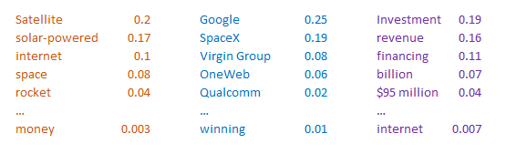
Output of LDA
TOPIC 1
TOPIC 2
TOPIC 3
Notes:
Output of LDA :
So finally it gives you the topics (Say the top n topics )
These are nothing but the multinomial over words in the document :When I mean multinomial this is nothing but the % of frequency distribution of words in the document.
Satellite occurs very frequency because it has a high prob (ie % occurrence in the document)
Followed by solar power etc.
Now all topics contain all words except maybe the irrelevant words have lower probability

Slide 17
INDEX
Introduction to Topic Modelling
Types of Topic modelling
Intuition of LDA
Math Behind LDA
LDA in R

Slide 18
Math Behind LDA
How does this algorithm assign topics to each word?
TOPIC 1
technology,satellite,internet,space exploration
TOPIC 3
money,investment,billion,financing,etc
How are we going to decide whether a new word W belongs to topic T ?
Questions to consider :
How often does “money” appear in topic T elsewhere? If “money” often occurs in discussions of Topic T, then this instance of “money” might belong to topic T as well.
How common is topic T in the rest of this document?
Notes:
Now let’s take a look at the math behind LDA.
Let’s start again.
Say we’ve got a collection of documents, and we want to identify underlying “topics” that organize the collection. Assume that each document contains a mixture of different topics. Let’s also assume that a “topic” can be understood as a collection of words that have different probabilities of appearance in passages discussing the topic.
Taking the same example:
Topic1 : technology,satellite,internet,space exploration
Topic2 : money,investment,billion,financing,etc

Slide 19
Math Behind LDA
For each possible topic T,
Multiply the frequency of this word type W in T by the number of other words in document D that already belong to T.
What is the output?
The result will represent the probability that this word came from topic T
$$P\left(T | W,D\right)=\frac{\# words W in the topic T}{\# words in the document D}∗(\#words in D that belong to T)$$
probabilistic topic modelling
Notes:
This actually comes from the Bayes theorem. Here we are trying to find the prob that this new word belongs to a given topic. We then choose that topic (or class) that has the highest probability.
For each possible topic T,
Multiply the frequency of this word type W in T by the number of other words in document D that already belong to Z.
What is the output?
The result will represent the probability that this word came from topic T
The overall emphasis on probability in this technique, of course, is why it’s called probabilistic topic modelling.
So we start with randomly assigning each word
We could go through the collection, word by word, and reassign each word to a topic, guided by the formula above. As we do that,
a) words will gradually become more common in topics where they are already common.
b) topics will become more common in documents where they are already common.
Thus our model will gradually become more consistent as topics focus on specific words and documents. But it can’t ever become perfectly consistent, because words and documents don’t line up in one-to-one fashion. So the tendency for topics to concentrate on particular words and documents will eventually be limited by the actual, messy distribution of words across documents.

Slide 20
INDEX
Introduction to Topic Modelling
Types of Topic modelling
Intuition of LDA
Math Behind LDA
LDA in R

Slide 21
LDA Packages in R

Slide 22

RECAP
Notes:
Closing Audio to be recorded
Under this topic we have discussed in detail about
…..
That’s it for this topic.
For any queries, do email us at info@jigsawacademy.com
Thanks!

Slide 23
THANK YOU

